Slide 1
SWEN90009 Software Requirements Analysis
High Fidelity Prototypes
2022 - Semester 1
Tutorial Week 9
Copyright University of Melbourne 2017

Slide 2
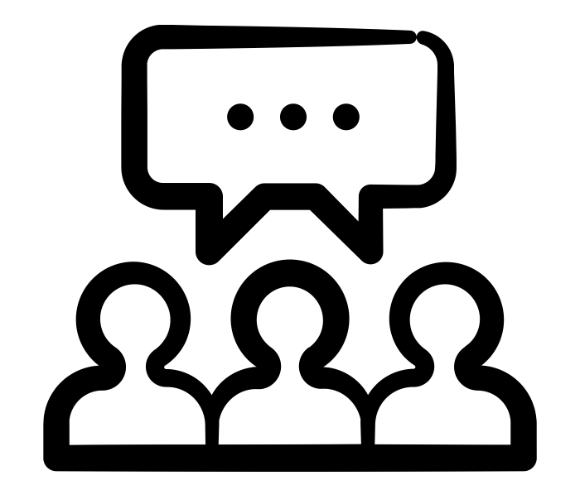
Today’s Aim
Discuss
- What value does High Fidelity Prototype add to our project?
- Why should we attempt mood boards, wireframe and basic UI components design prior to High Fidelity Prototype?
Work on your project
Mood board
Wireframe
Basic UI components
High fidelity prototype

Slide 3
Discuss
What value does High Fidelity Prototype add to our project?

Slide 4
Mood boards and Wireframe – Why?
Colton Carner (2021)

Slide 5
Basic UI elements – Why?
High fidelity prototype usually takes a lot of effort – very likely more than one team members will work on it. How to ensure there is consistency?
Mood board – how to translate it to actual design?
Notes:
These are actual mistakes of past students:
Inconsistency in High Fidelity Prototype because multiple team members worked on it and there is no agreement prior among the team members.
Students finished the mood board and that was it – left there and forgotten. It became a standalone activity that is NOT related to anything else.

Slide 6
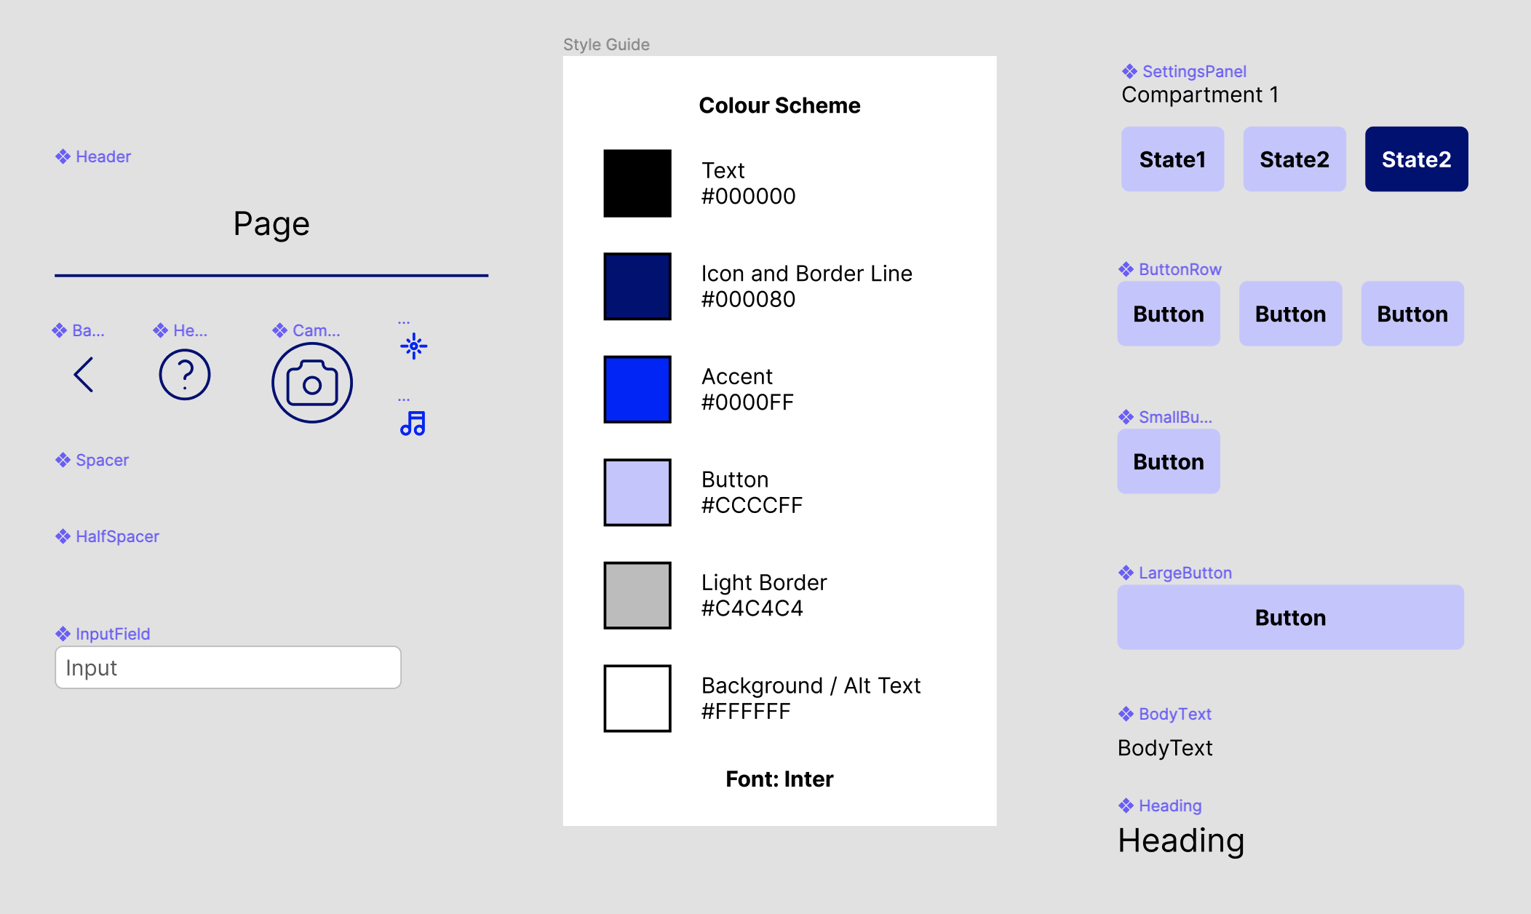
Basic UI elements – Why?
From experience, this exercise does not take long (less than 1 hour), and does not need to be perfect.
Highly beneficial – you can ensure there will be consistency across members
Verifies that what you have designed in your mood board actually translate to a good design
Before HFP
Example by Glenn Phillips
Notes:
We strongly encourage you to conduct this activity. The cost is very small for LOTS of benefits.
This should be done BEFORE you start working on your High Fidelity Prototype

Slide 7
Work on your project – mood board
You can download the template on Canvas or use other tools as suggested in lecture.
Divide your group into two sub-groups (2-2 in case of 4 members, 3-2 in case of 5 members and keep the group intact if there are only 3 members);
Construct a mood board. Both sub-groups, without discussing with each other, should construct a mood board for their projects [25 minutes working in this task]. Your mood board should include visual references (photos, illustrations, icons), typefaces (1-3) and colour palette. This article can help you with this task: https://www.creativebloq.com/inspiration/get-most-out-moodboards-91516630. The goal is to set the mood of the system. Be abstract.
Present your mood board at the end of 25 minutes. Vote for the best one (or combine them into one) [5 - 10 minutes];
Notes:
GitHub worksheet

Slide 8
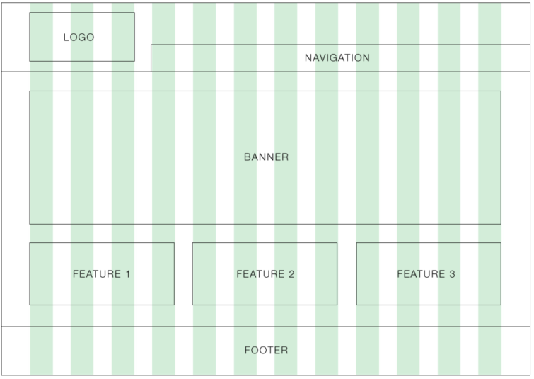
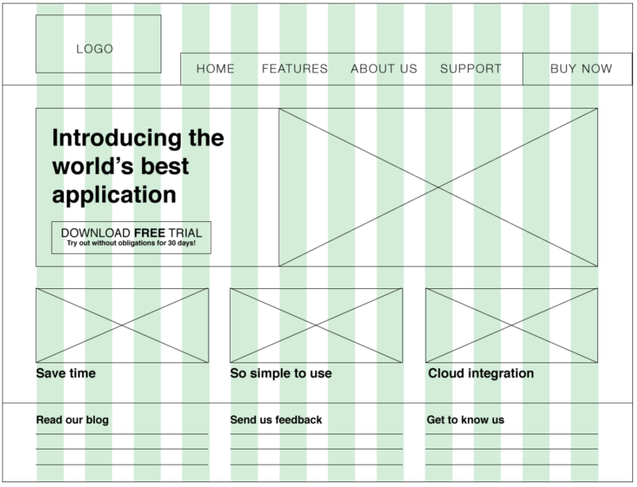
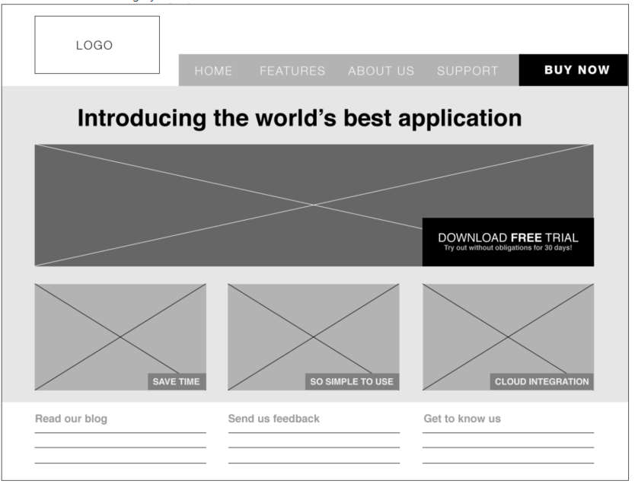
Work on your project – Wireframe
Wireframe your system [https://webdesign.tutsplus.com/articles/a-beginners-guide-towireframing--webdesign-7399];
Draw the boxes of your system (grid-based). Different team members can work on different boxes (or screens);
Use typography to define the information architecture of the boxes/screens;
Tune the wireframe with greyscale
Notes:
GitHub worksheet

Slide 9

The End
Thank you!
Notes:
.

